Slide 1

Computer Application
Class IX
29/11/13

Slide 3

Topic
Array
Types Of Array
Search
Sort
2D Printing
Summary

Slide 4
Array
An array is a container object that holds a fixed number of values of a single type.
An array is a collection of same data type
Syntax:
datatype variable[] = new datatype[size];
Example:
int salary[]= new int[10]; or
string name[]= new string[120];
Subscript/index – The element numbers in [] of an array
Base Type – Data type of array elements

Slide 5

Array(Contd…)
Advantages
It Stores many elements at a time
Allows to access data randomly
Easy to specify and Simple
Fast Sequential Access
Disadvantages
Fixed Size
Data will wiped out after modifying the size
Careful design required
Chance of Memory wastage

Slide 6
Types of Array
Single Dimension
It is comprised of finite homogeneous elements
Example
double x[];
x= new double[5];
Multi Dimension
It is comprised of elements, each of which itself an array
It is represented as Matrix (Rows and columns)
Example
string x[][];
x= new string[5][3];

Slide 7
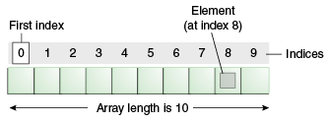
Array Single Dimension (Contd…)
int phone[] = new int[N];
N – represents numeric value
Legal subscripts for an array having N Element is 0 ~ (N-1)
int phone[] = new int[10];

Slide 8
Array MultiDimension (Contd…)
Example
int customer[][] = new int[4][5];
Columns
[0][0] | [0][1] | [0][2] | [0][3] | [0][4]
[1][0] | [1][1] | [1][2] | [1][3] | [1][4]
[2][0] | [2][1] | [2][2] | [2][3] | [2][4]
[3][0] | [3][1] | [3][2] | [3][3] | [3][4]
Rows

Slide 9
Array(Contd…)
Predict the following code is Legal or Not
int[] a;
a[] = new int[10];
int[] b;
b[10] = new int[-10];
int b[][];
b = new int[1][1];
int a[][];
a[][] = int [12][2];
int a=12,b=8;
int c[][] = new int[a-b][2];
Illegal
Illegal
Legal
Illegal
Legal

Slide 10
Guided Practice for Single Dimensional Array
public class Array
{
public static void main(String args[])
{
int marks[] = new int[5];
System.out.println("Elements are " + marks.length);
System.out.println("Default value: " + marks[0]);
// Now assign values
marks[0] = 50;
marks[1] = 60;
marks[2] = 70;
marks[3] = 80;
marks[4] = 90;
System.out.println("Value of 1st element: " + marks[0]);
System.out.println("\nPrint the values in a single row");
for(int i = 0; i < marks.length; i++)
{
System.out.print(marks[i] + "\t");
}
}
}

Slide 11
Guided Practice for Multidimensional Array
public class TwoDArray
{
public static void main(String args[])
{
int twoD[][]= new int[4][5];
int i, j, k = 0;
for(i=0; i<4; i++)
{
for(j=0; j<5; j++)
{
twoD[i][j] = k;
k++;
}
}
for(i=0; i<4; i++)
{
for(j=0; j<5; j++)
{
System.out.print("Two Dimensional[" + i + "][" + j + "] \t" + twoD[i][j]);
System.out.println();
}
}
}
}

Slide 12
Search
Linear or sequential
Binary

Slide 13
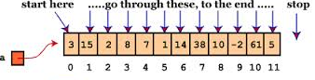
Linear Search
Compared with given Item to be searched for, one by one
ALGORITHM:
First Element at 0th Index is compared with Item,then at 1st index is compared with Item until (n-1)th index
Example:
int a[] = new int[12];
PATTERN

Slide 14
Guided Practice for Linear Search(Contd…)
import java.util.*;
public class LinearSearch
{
public static void main(String args[])
{
int c, n, search, array[];
Scanner in = new Scanner(System.in);
System.out.println("Enter number of elements");
n = in.nextInt();
array = new int[n];
System.out.println("Enter " + n + " integers");
for (c = 0; c < n; c++)
{
array[c] = in.nextInt();
}
System.out.println("Enter value to find");
search = in.nextInt();
for (c = 0; c < n; c++)
{
if (array[c] == search)
{
System.out.println(search + " is present at location " + (c + 1) + ".");
break;
}
}
if (c == n) /* Searching element is absent */
System.out.println(search + " is not present in array.");
}
}

Slide 15
Binary Search
ALGORITHM:
Search ITEM is compared with MIDDLE element of array
If Search ITEM Matches with the element then
search finishes
If Search ITEM is less than middle
perform search in first half of the array
else
perform search in latter half of the array
NOTE:
Binary Search will work only for sorted arrays

Slide 16
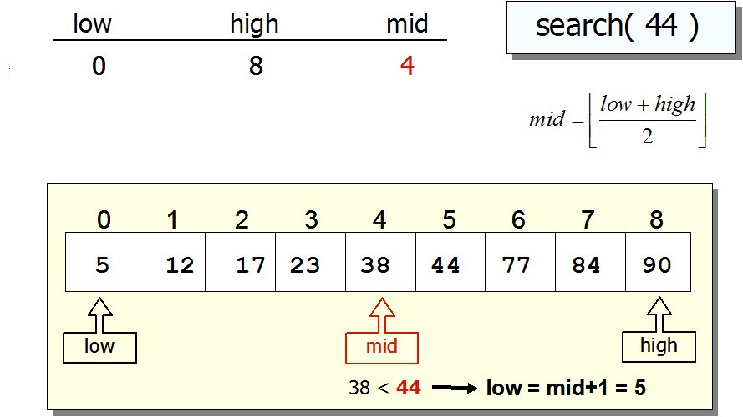
Binary Search pattern(Contd…)
MID= (LOW + HIGH)/2
BEG/LOW = MID + 1
LAST/HIGH = MID - 1

Slide 17
Binary Search pattern(Contd…)
0 | 1 | 2 | 3 | 4 | 5 | 6 | 7 | 8 | 9 | 10 | 11
10 | 12 | 14 | 21 | 23 | 28 | 31 | 37 | 42 | 44 | 49 | 53
Beg
Last
Search for 44
Step I
Beg=0;last=11; mid=(0+11)/2 = 5.5 ➔ int of 5.5 ➔ 5
Step II
Beg
28 | 31 | 37 | 42 | 44 | 49 | 53
Last
Data[Mid]➔ 28.
i.e 28 <44 then
beg = mid + 1 ➔ 5 + 1 ➔6
31 | 37 | 42 | 44 | 49 | 53
Last
Step III
Beg
42 | 44 | 49 | 53
Last
Mid =(beg+last)/2 ➔ (6+11)/2 ➔ 8
Data[8]➔ 42. i.e 42<44 then beg=mid+1➔8+1➔9
Beg
Last
44 | 49 | 53
Beg

Slide 18
Binary Search pattern(Contd…)
Step IV
mid=(9+11)/2 = 10 ➔ 10
Data[10] i.e., 49>44 then
Last = mid-1
Last=10-1➔9
Last
Beg
44 | 49 | 53
Step V
Mid=(beg + last)/2➔(9+9)/2➔9
Data[9] i.e 44 =44
Last
Beg
44

Slide 19
Guided Practice for Binary Search (contd…)
import java.util.*;
public class BinarySearch
{
public static void main(String args[])
{
int c, first, last, middle, n, search, array[];
Scanner in = new Scanner(System.in);
System.out.println("Enter number of elements");
n = in.nextInt();
array = new int[n];
System.out.println("Enter " + n + " integers");
for (c = 0; c < n; c++)
{
array[c] = in.nextInt();
}
System.out.println("Enter value to find");
search = in.nextInt();
first = 0;
last = n - 1;
middle = (first + last)/2;
while( first <= last )
{
if ( array[middle] < search )
{
first = middle + 1;
}
else if ( array[middle] == search )
{
System.out.println(search + " found at location " + (middle + 1) + ".");
break;
}
else
{
last = middle - 1;
}
middle = (first + last)/2;
}
if ( first > last )
System.out.println(search + " is not present in the list.\n");
}
}
1
2

Slide 20
Homework
Write an algorithm and step to find 12 from a given array using Binary Search
Write an algorithm and step to find 99.09 from a given array using Binary Search
Write an algorithm and step to find .98 from a given array using Binary Search
10 | 12 | 14 | 21 | 23 | 28 | 31 | 37 | 42 | 44 | 49 | 53
11.3 | 12.3 | 14.21 | 45.67 | 60.33 | 71.87 | 99.09 | 100.01 | 112.32 | 211.23
.1 | .2 | .3 | .6 | .23 | .34 | .56 | .78 | .79 | .98

Slide 21
Linear/Binary Search Differences
Linear Search
Binary Search
Can Work on both sorted and unsorted arrays
Reads and compares each element of the array one by one till a match found
Tends to become inefficient as size of array increase
Works on sorted arrays only
Works by dividing the array into two segments out of which only one needs to be searched
It is more efficient than linear search in case of larger sized arrays

Slide 22
Sorting
It is a process of arranging the array elements in a specified order i.e. ascending or descending
Types of Sorting
Selection Sort
Bubble Sort
Heap Sort
Shell Sort
Shuttle Sort
Quick Sort

Slide 23
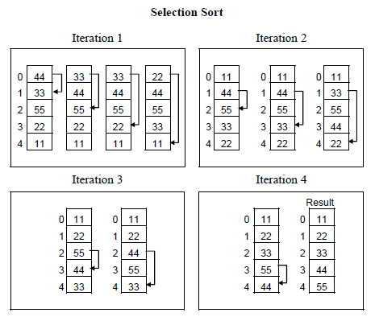
Selection Sort
The basic idea of a selection sort is to repeatedly select the smallest key in the remaining unsorted array
During each pass, the unsorted element with the smallest value is moved to its proper position in the array
PATTERN
int a[] = new int[4];

Slide 24
Guided Practice for Selection Sort(Contd…)
Example :
public class SelectionSort
{
public static void main(String[] args)
{
int arr[]={234,151,123,4,5342,76,48};
int arrLength = arr.length;
for(int i=0;i<arrLength-1;i++)
{
int min=i;
for (int k=i+1;k<arrLength;k++)
{
if(arr[k]<arr[min]) // use > for Descending
{
min = k;
}
}
if (i != min)
{
int temp=arr[i];
arr[i]=arr[min];
arr[min]=temp;
}
}
for (int j=0;j<arrLength;j++)
{
System.out.println(arr[j]+" ");
}
}
}

Slide 25
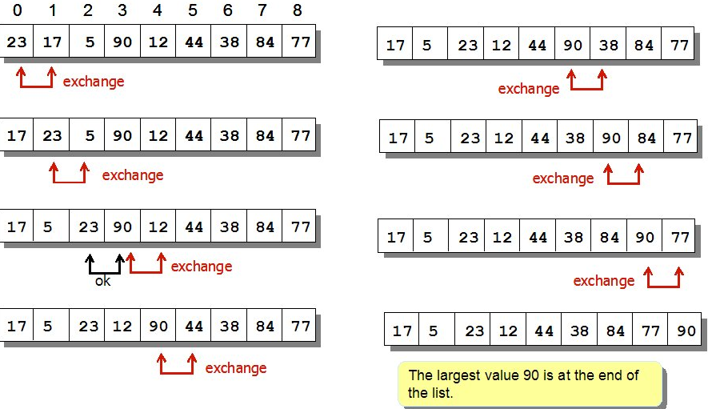
Bubble Sort
The basic idea of a bubble sort is to compare two adjoining values and exchange them if they are not in proper order.
PATTERN

Slide 26
Guided Practice for Bubble Sort(Contd…)
Example :
import java.util.*;
public class BubbleSort
{
public static void main(String []args)
{
int n, c, d, swap;
Scanner in = new Scanner(System.in);
System.out.println("Input number of integers to sort");
n = in.nextInt();
int array[] = new int[n];
System.out.println("Enter " + n + " integers");
for (c = 0; c < n; c++)
{
array[c] = in.nextInt();
}
for (c = 0; c < ( n - 1 ); c++)
{
for (d = 0; d < n - c - 1; d++)
{
if (array[d] > array[d+1]) //use < for descending
{
swap = array[d];
array[d] = array[d+1];
array[d+1] = swap;
}
}
}
System.out.println("Sorted list of numbers");
for (c = 0; c < n; c++)
{
System.out.println(array[c]);
}
}
}
1
2

Slide 27
2D Printing
Rendering Models
Printable
It uses one PagePainter for entire document.Pages are rendered in sequence,starting with page zero,when last page get prints PagePainter will return NO_SUCH_PAGE value
2) Pageable
It is more flexible than Printable jobs.Each Pageable job will have a different layout and PagePainter.Page format for individual page can be set at ease.

Slide 28
2D Printing (Contd…)
Packages
import javax.swing.*;
import java.awt.*;
import java.awt.event.*;
import java.awt.event.print.*;
Class
PrinterJob
Graphics2D
Interface
Printable

Slide 29
Guided Practice for 2D Printing (Contd…)
javac PrintMe.java
java PrintMe

Slide 30

Challenges
1) Accept and display five students - Computer Application Marks using Arrays
2) Accept and sort five students mobile number in ascending order using arrays with Binary Sort
3) Write a program that reverse an array and stores it in the same array
4) Write a program that reverse an array and stores it in the new array
5) Accept 10 integers except zero, perform selection sort and display number in ascending order

Slide 31

Challenges (Contd…)
5) A = {4,6,1,2,3,10,19,23,7,8}
B = {19,23,7,8,3,10}
where A and B array values should be entered in command prompt.
Display the output in C array as given below
C = {4,6,1,2}

Slide 32
Challenges (Contd…)
6) Accept 5 integer values and store it in array. Display the Minimum, Maximum value in the array, along with sum of integer values in array.
7) Write a program to find sum of two matrix and display the output
8) Write a program to transpose the matrix
9) Write a program to multiply two matrix and display the output
10) Write a program to inverse the matrix

Slide 33

Summary
Array
Types of Array
Single Dimension
Multi Dimension
Search
Binary Search
Linear Search

Slide 34
Summary (Contd…)
Sort
Selection Sort
Bubble Sort
2D Printing
Printable
Pageable

Slide 35

FAQs

